Slide 1



VOIS Innovation
Marathon 2.0

Slide 2
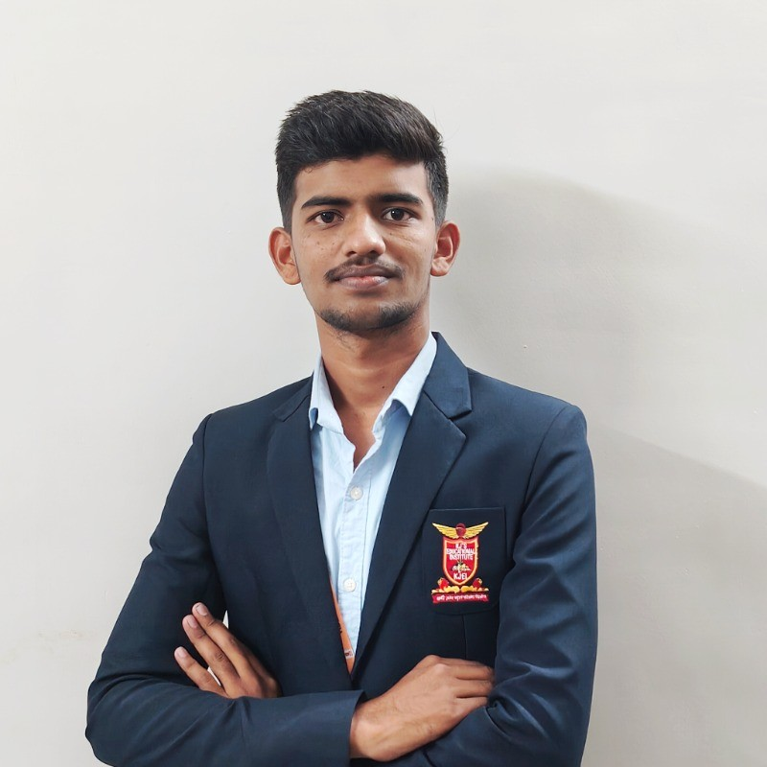

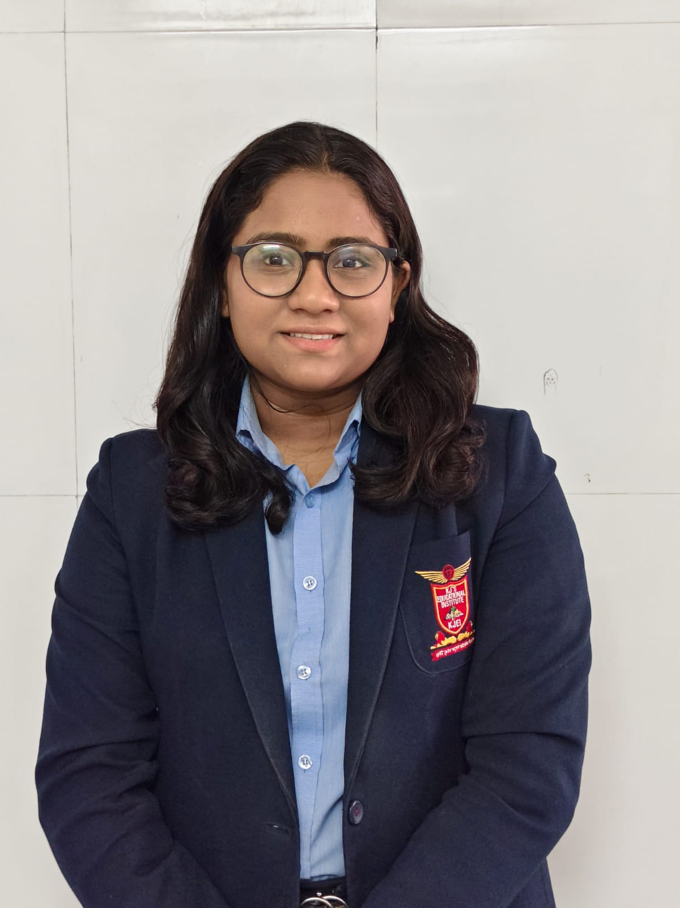
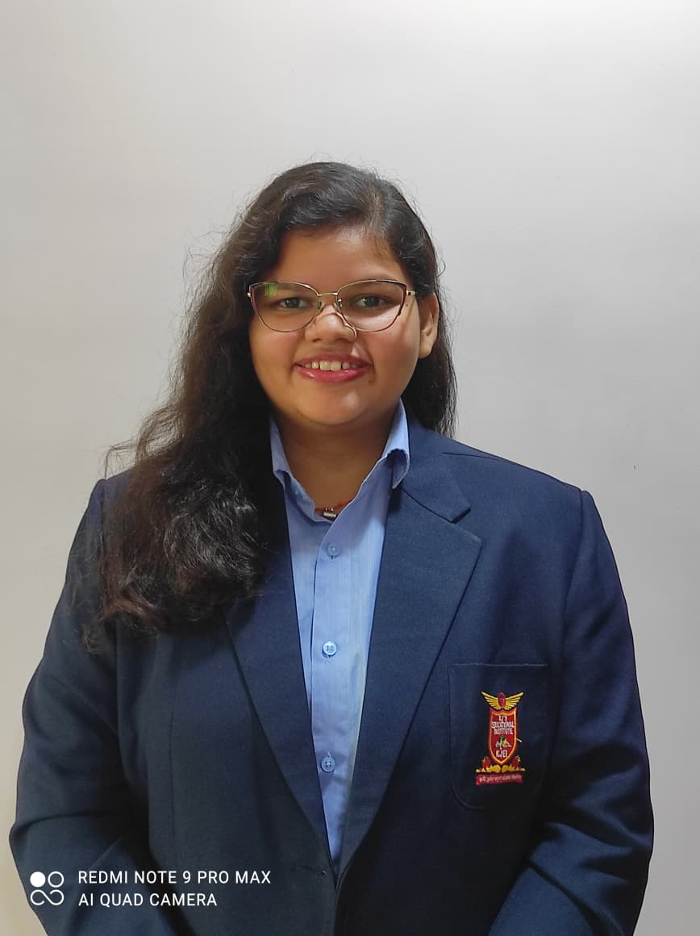
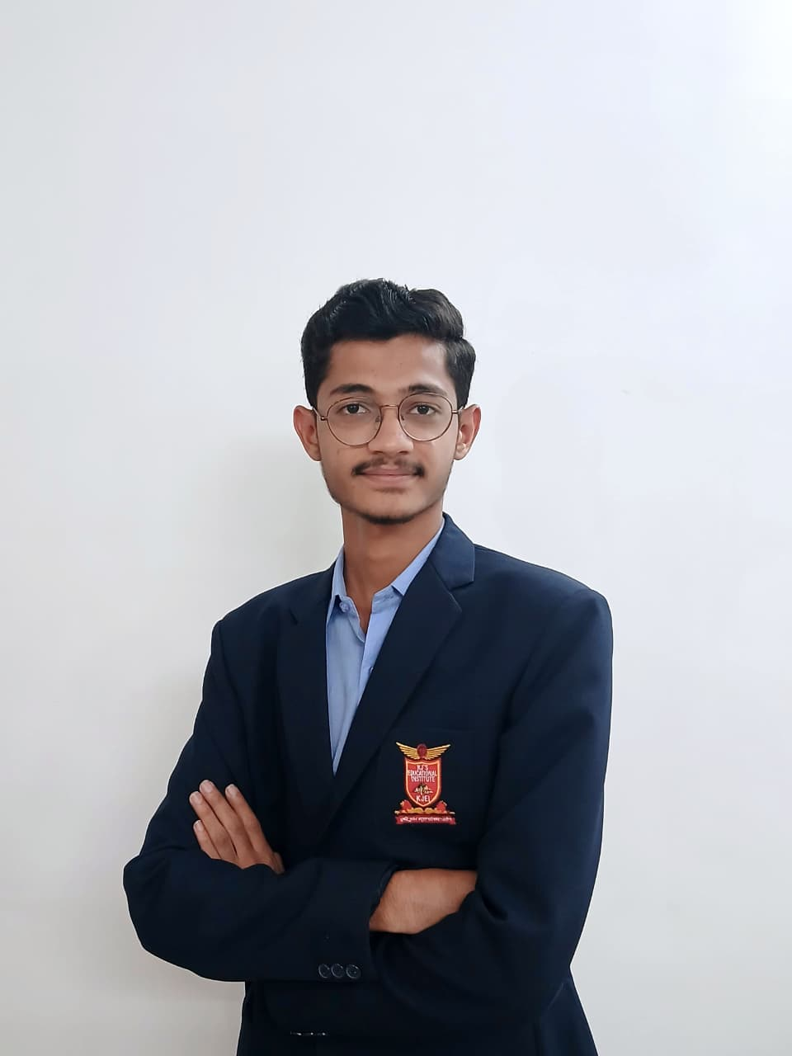
Project Title: AquaGuard – Water Quality Monitoring System
Team No. 41
Team Lead: Satyam Pisote ,Computer
Insert your professional photo
Insert your professional photo
KJ’s Educational Institute Trinity College of Engineering and Research,Pune,Maharashtra
Prachi Shelake,Computer
Vidhi Bawane,Computer
Nimish Borkar,Computer
Name, Branch

Slide 3
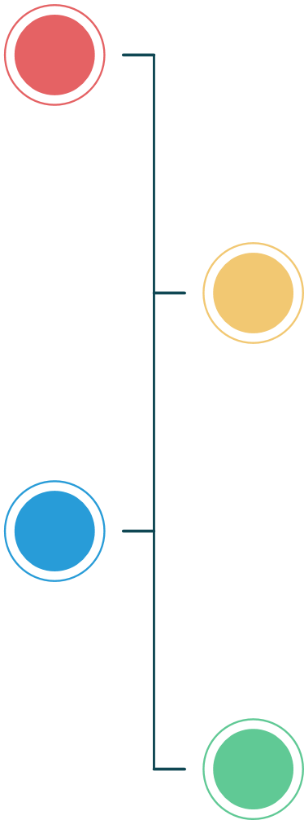




Problem Statement
Water Quality Monitoring System
The Challenge: Ensuring safe and usable water is difficult, as individuals and communities often struggle with:
Manual and Infrequent Testing – Traditional water quality testing is time-consuming, costly, and does not provide continuous monitoring.
Lack of Real-Time Information – Sudden changes in water quality (TDS, turbidity, temperature, minerals) often go undetected until water becomes unsafe.
Delayed Response to Contamination – Absence of automated alerts results in slow action, increasing health risks.
Limited Intelligent Decision Support – Existing systems provide raw data but lack intelligent analysis, insights, and autonomous decision-making.
Without a reliable, intelligent, and continuous monitoring system, users remain unaware of unsafe water conditions, leading to health issues, poor water management, and delayed preventive action.

Slide 4
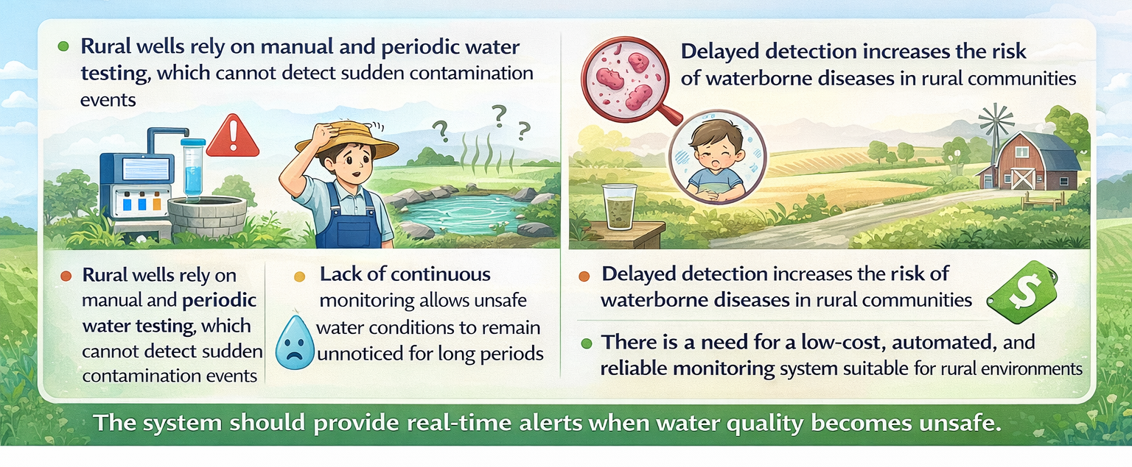
Need of Project

Slide 5
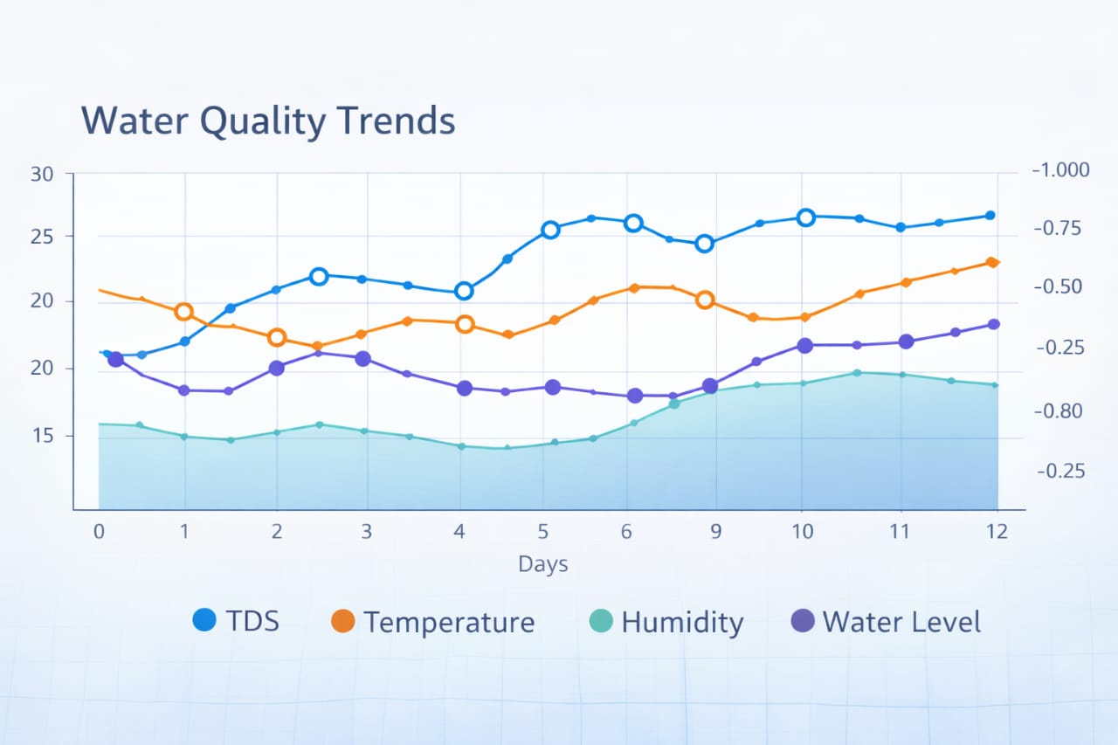
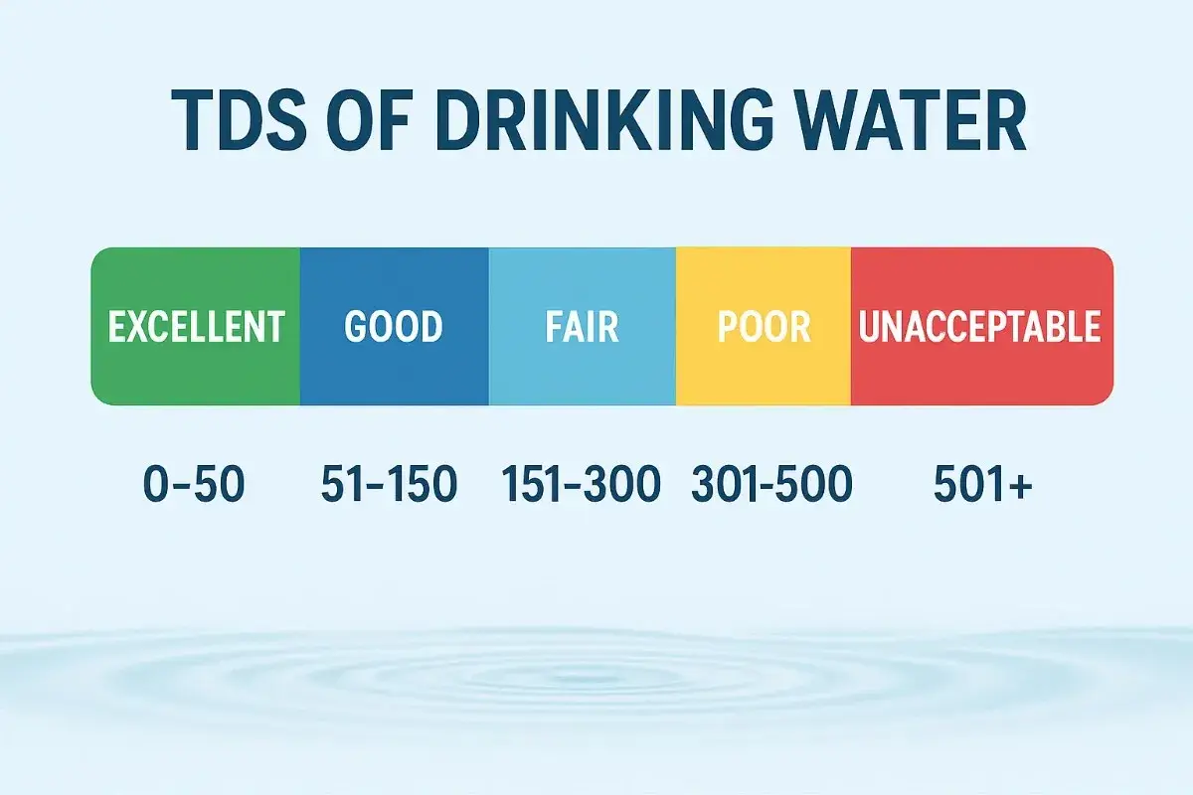
Proposed Solution
Aspect | Description
Core Approach | Agentic AI–driven intelligent water quality monitoring system
Monitoring Style | 24×7 autonomous real-time observation
Decision Mechanism | Threshold-based reasoning with intelligent analysis
AI Intelligence | GenAI (LLaMA v3 / v3.2) for insights and recommendations
Workflow Platform | Langflow for AI orchestration and integration
Alert System | Automatic Email & SMS notifications
Deployment | Cloud-connected, scalable, and low-cost

Slide 6
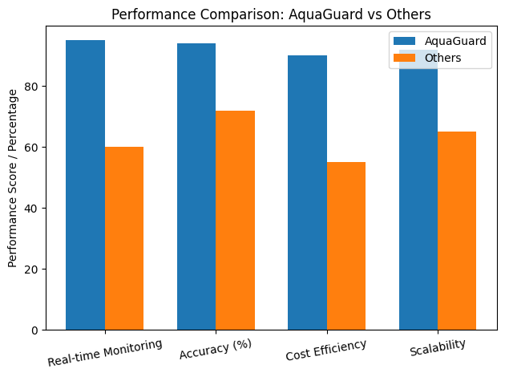
Solution Overview
Langflow Platform–Driven Intelligent Water Monitoring Solution
• Langflow Platform is used to design and manage the complete AI workflow, integrating IoT data with intelligent decision-making
• Agentic AI continuously monitors water quality data 24×7, autonomously evaluating conditions and triggering actions
• Generative AI (LLaMA v3 / v3.2) analyzes real-time and historical data to generate insights, summaries, and recommendations
• RAG (Retrieval-Augmented Generation) enables context-aware responses by retrieving relevant historical records, safety thresholds, and system knowledge
Sense → Analyze → Reason → Decide → Alert

Slide 7
Technology used
1
ESP32 Microcontroller – Data acquisition and wireless transmission
2
Water Quality Sensors (TDS, Turbidity, Temperature) – Real-time parameter monitoring
Embedded C (Arduino IDE) – Firmware development
3
4
WiFi (HTTP/MQTT Protocols) – Data communication to serve
5
Cloud Database & Web Dashboard – Data storage, visualization, and monitoring
5

Slide 8
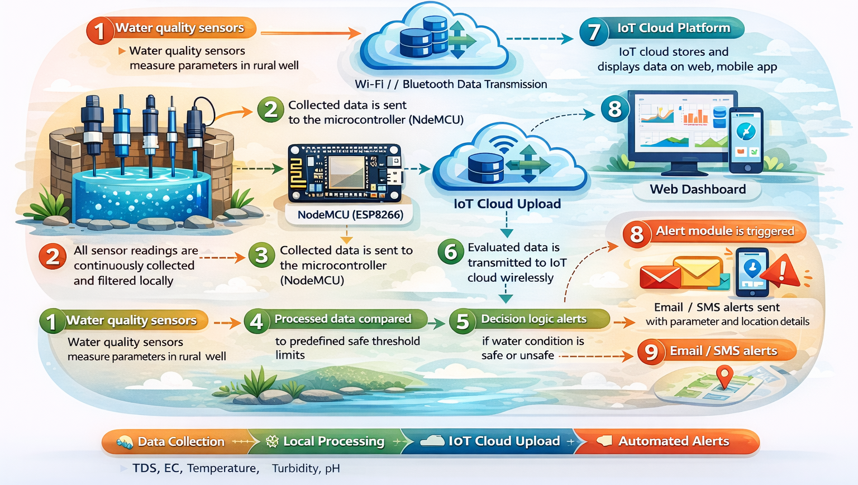
Technical flow diagram -

Slide 9
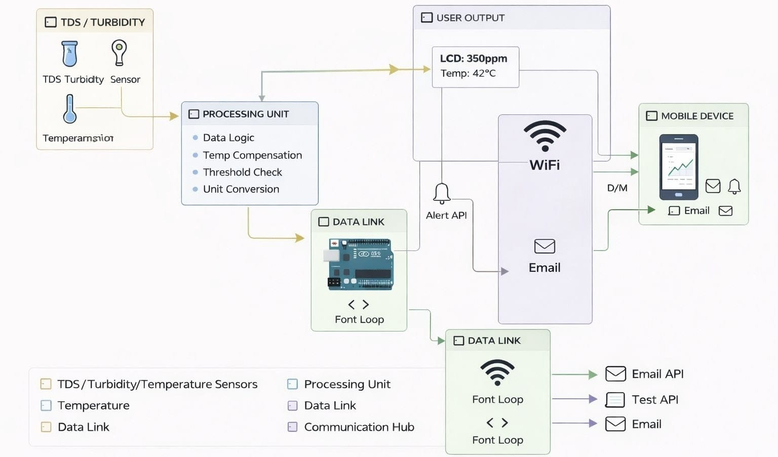
Architecture Blueprint

Slide 10
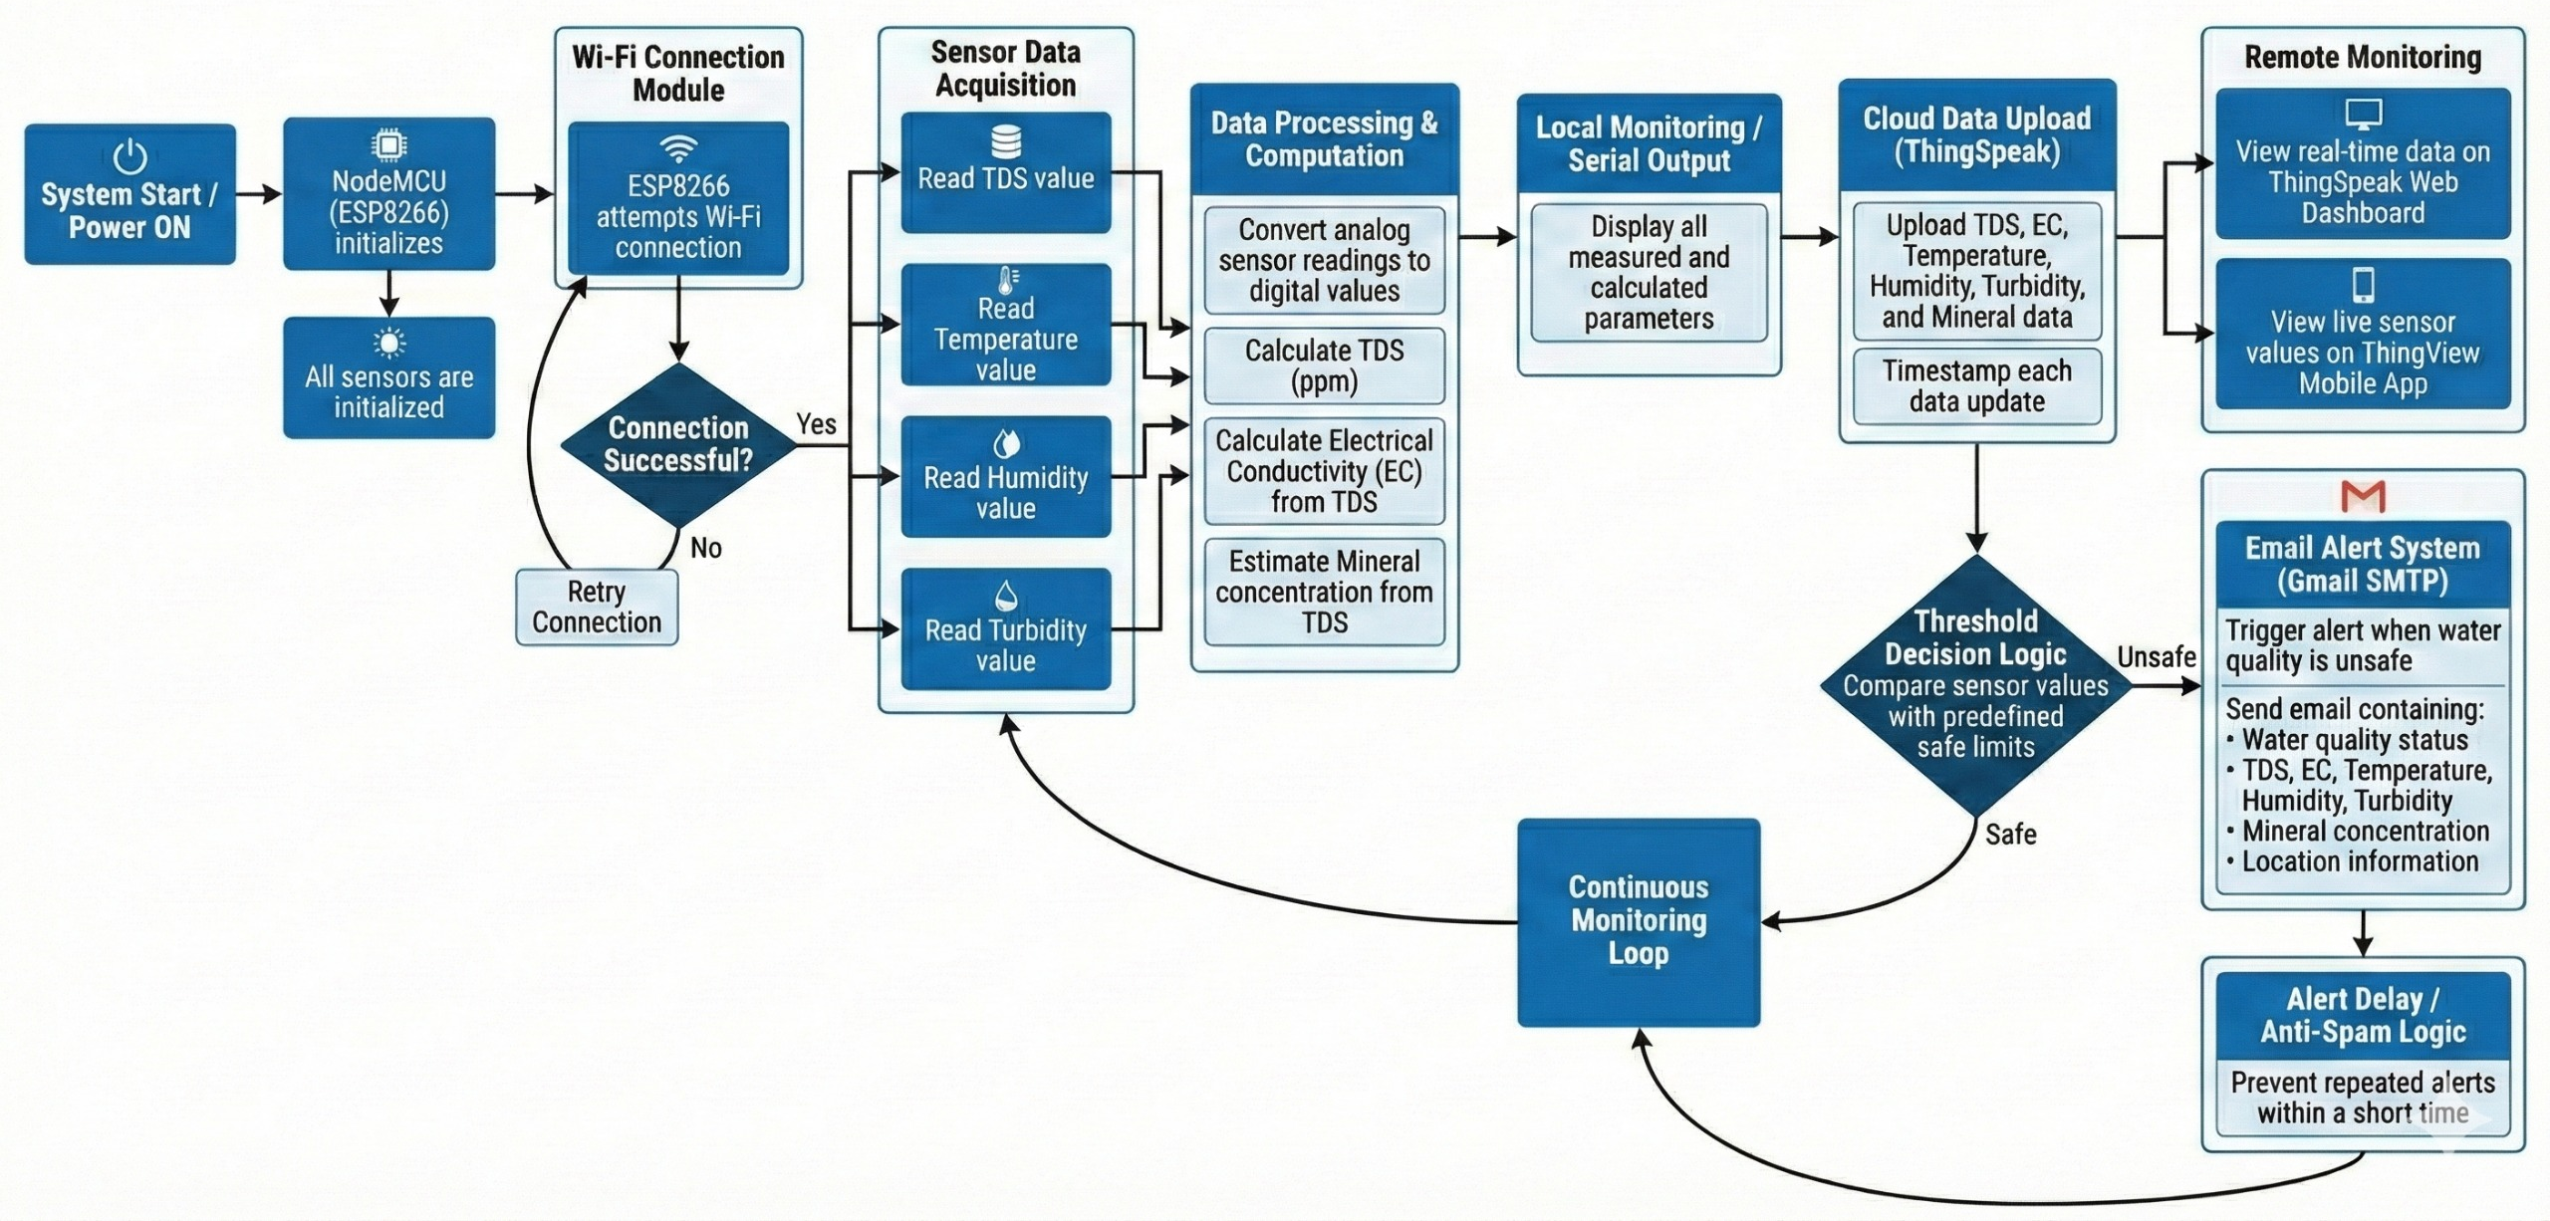
Workflow diagram

Slide 11
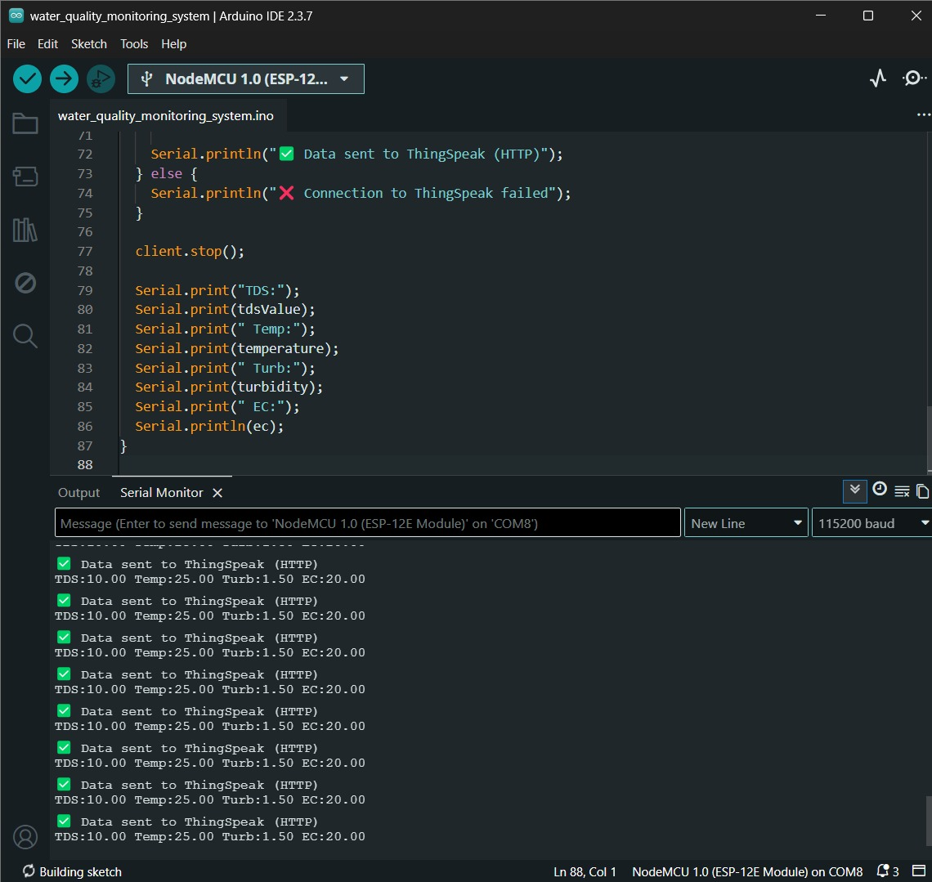
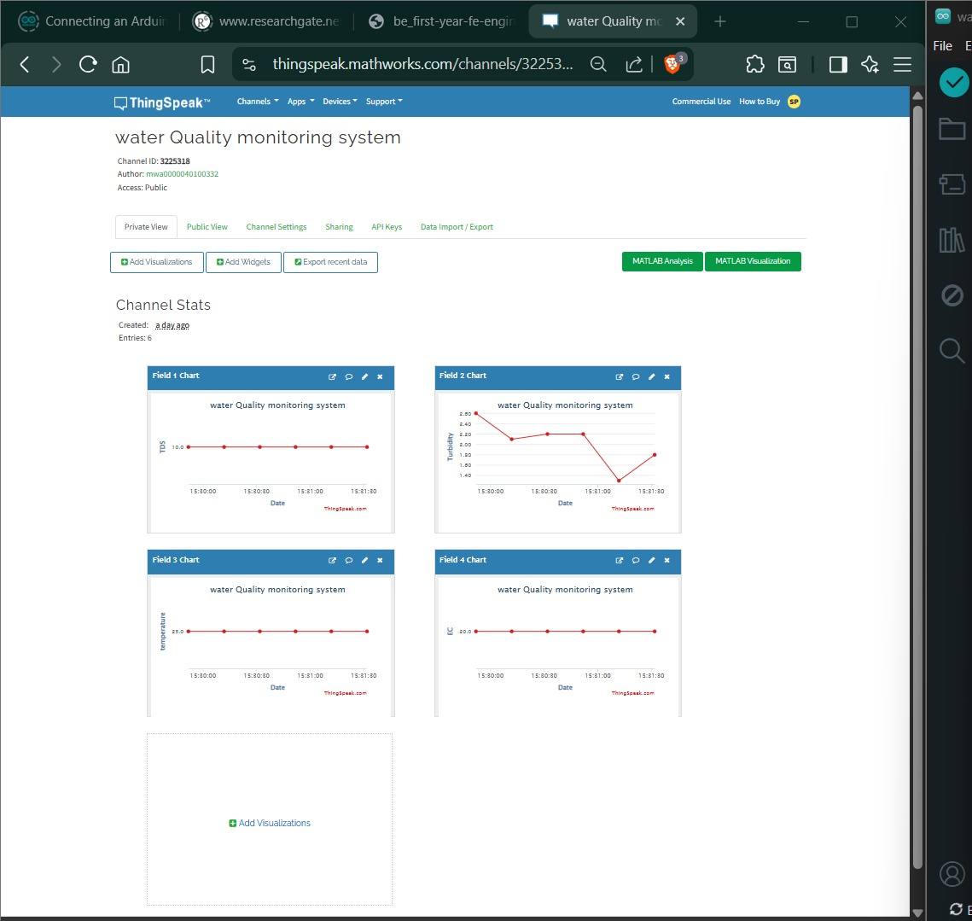
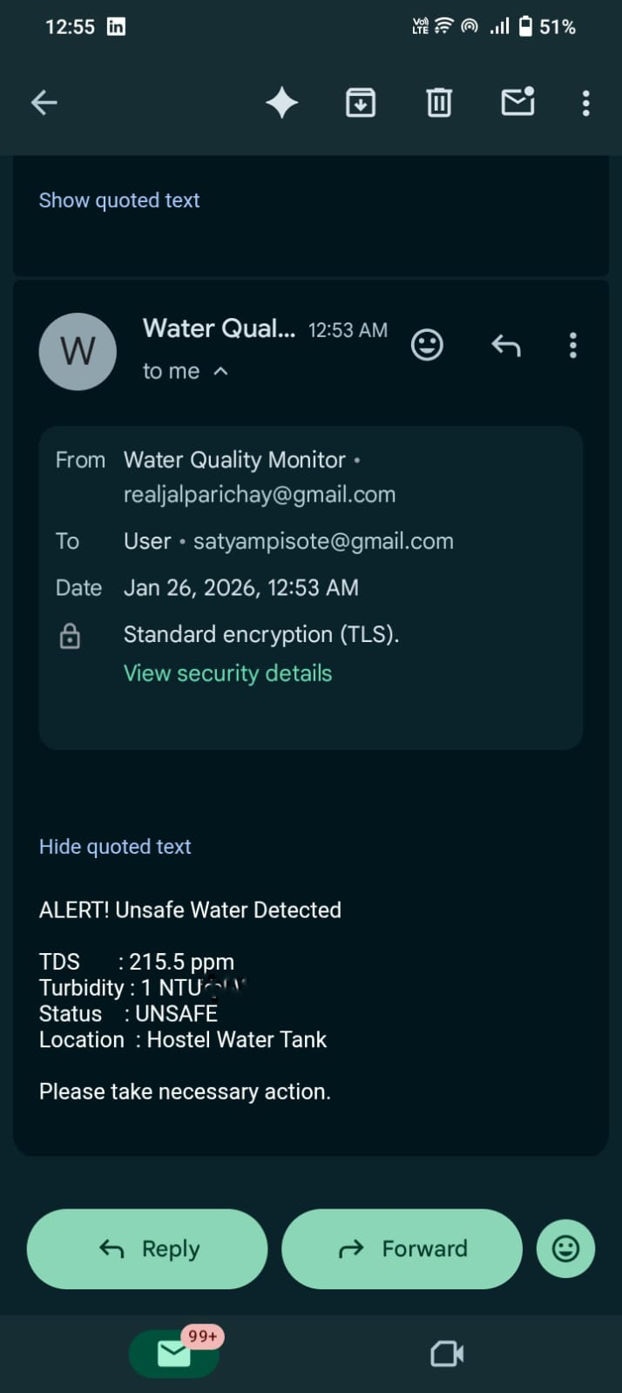
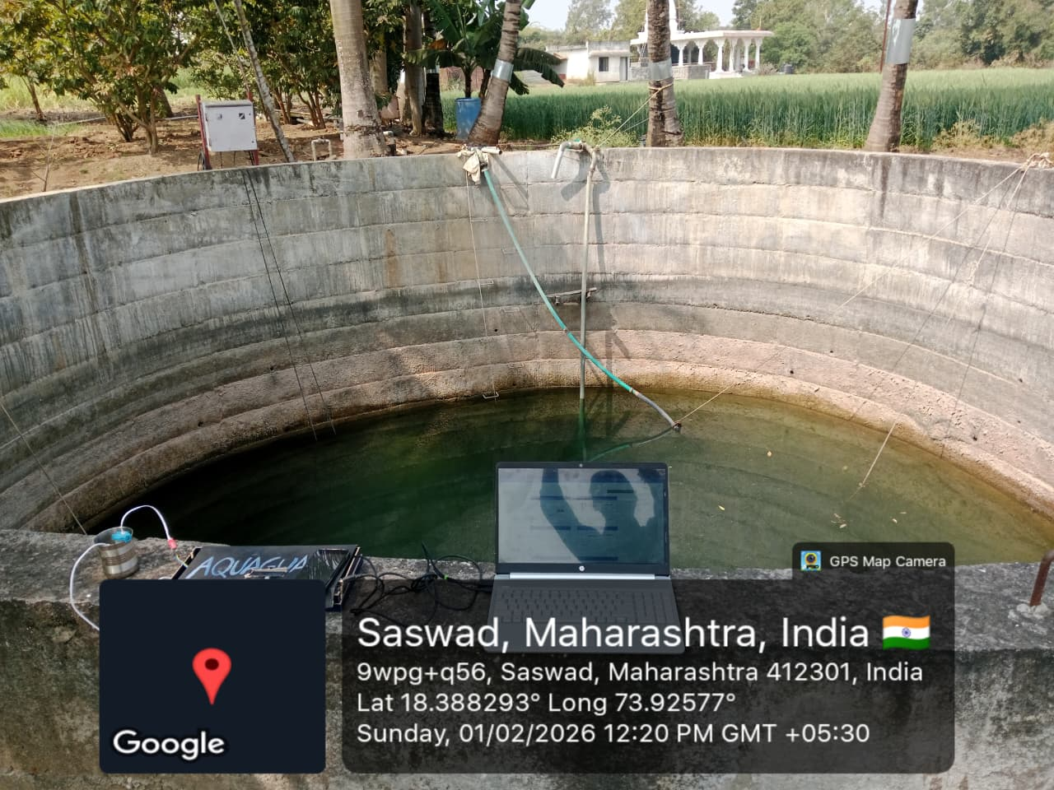
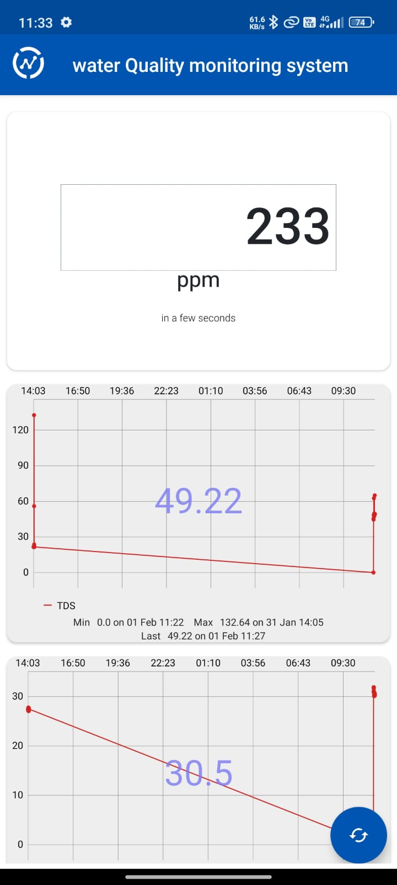
Screen shots of our project -

Slide 12
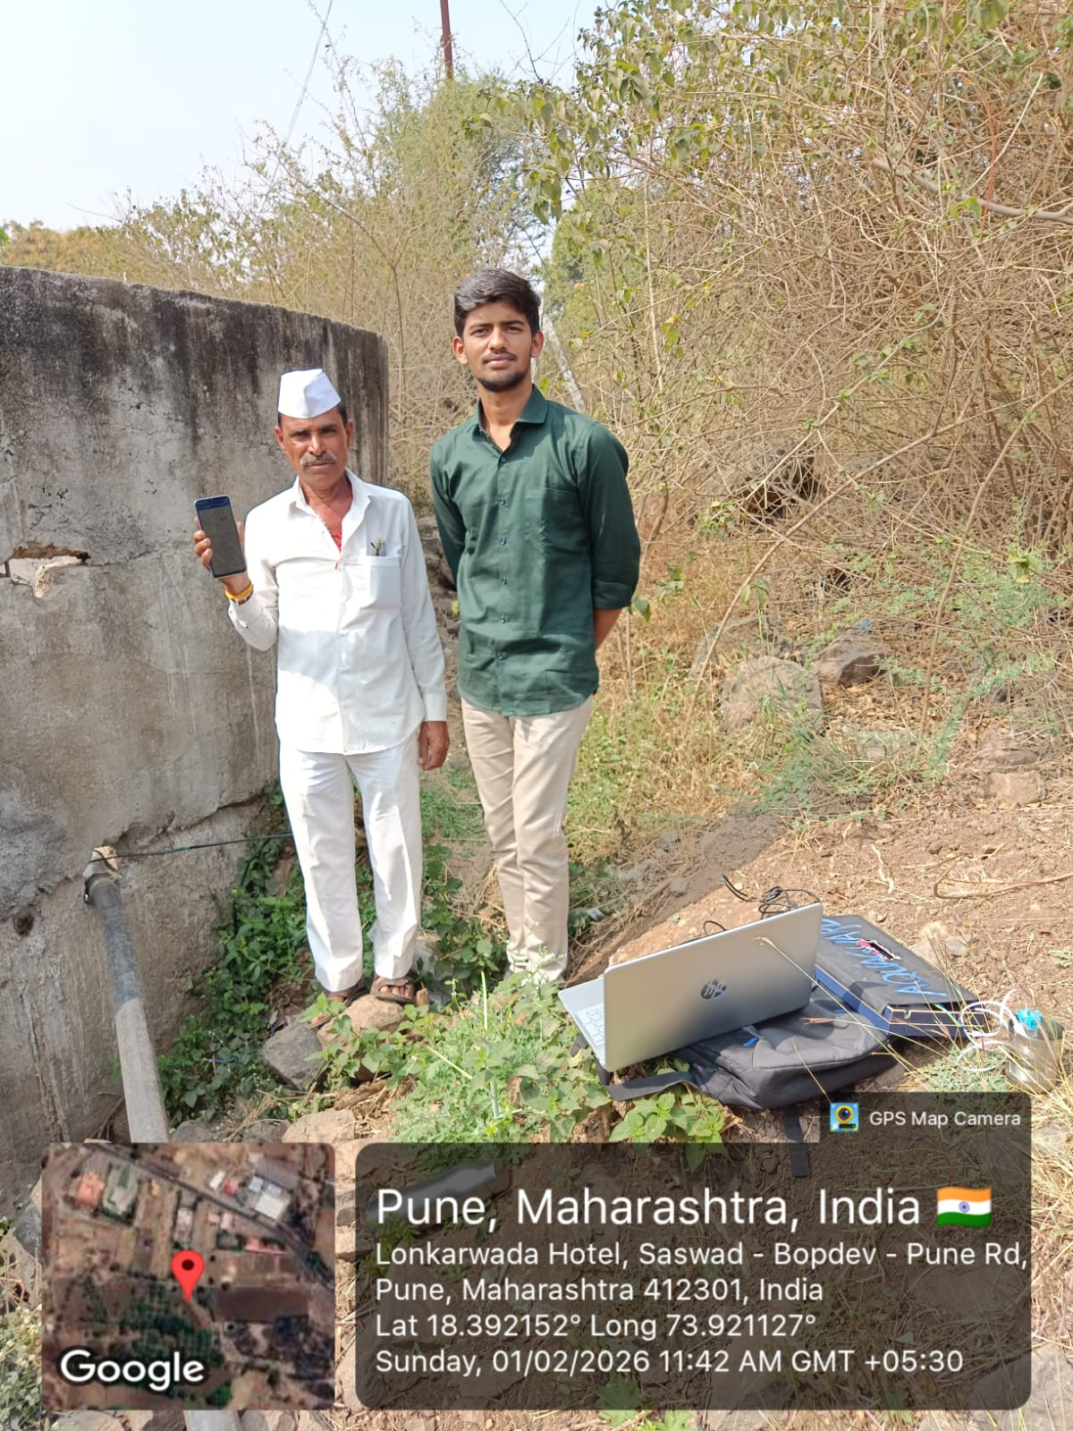
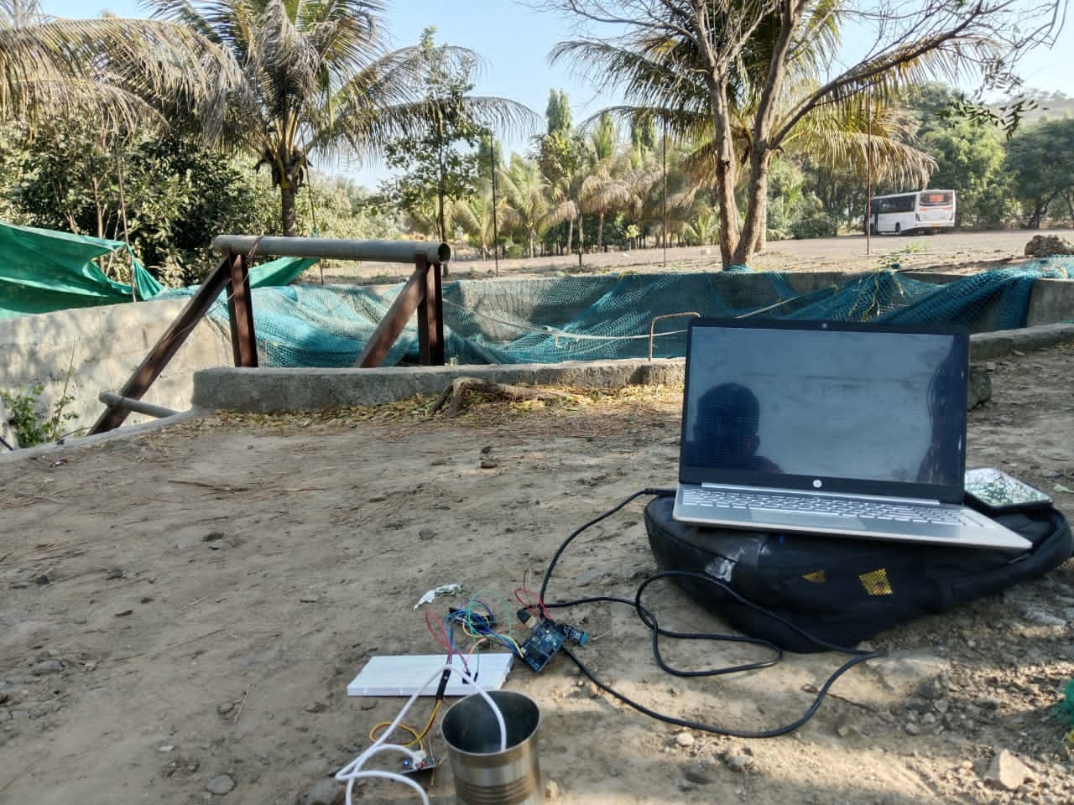
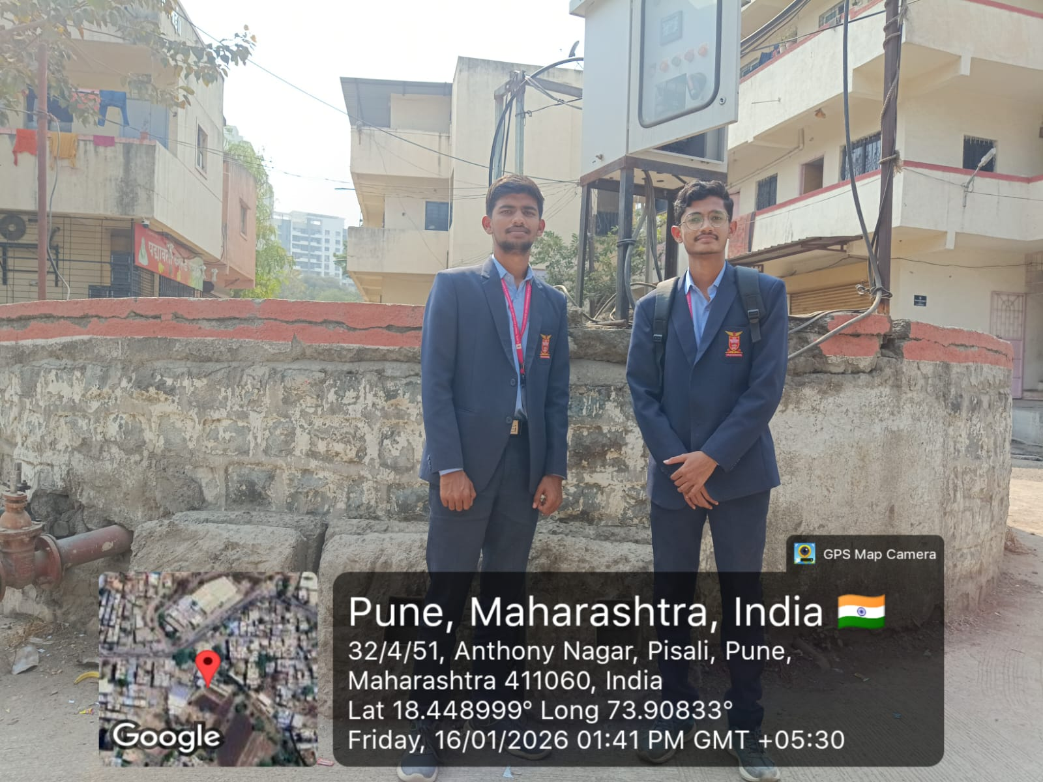
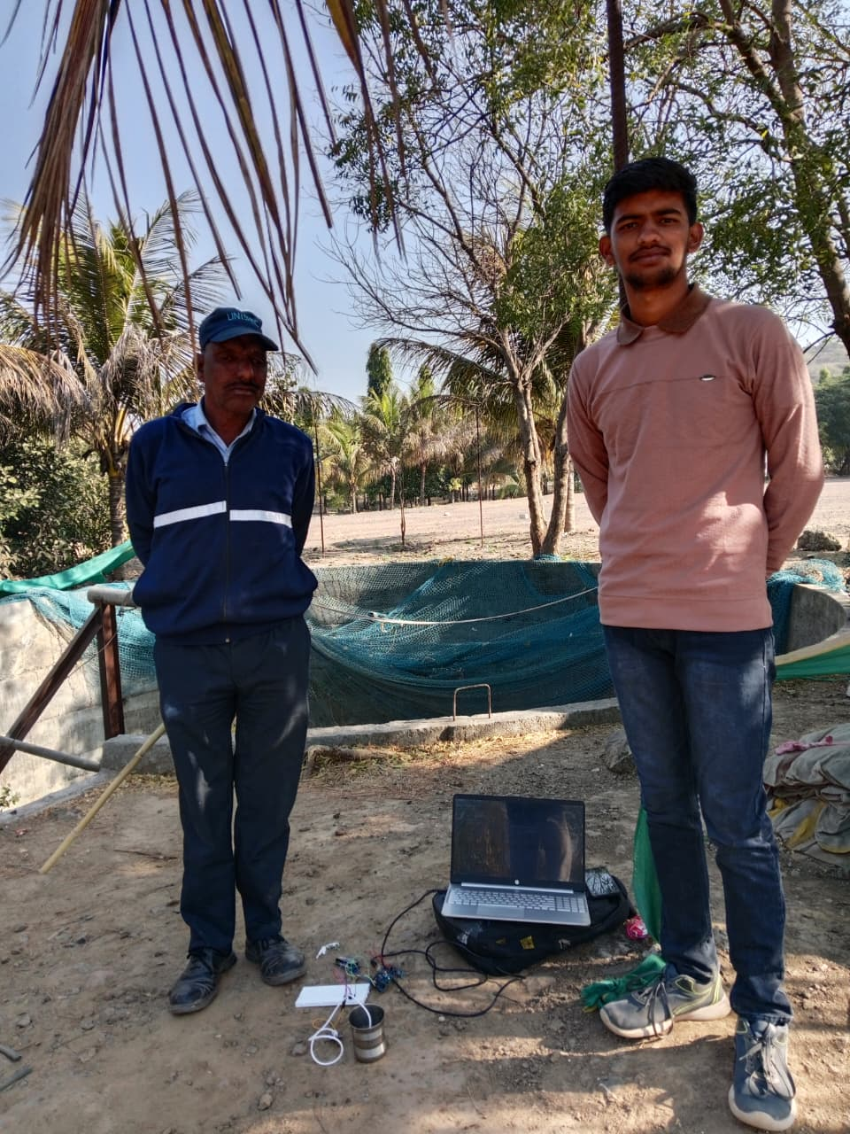
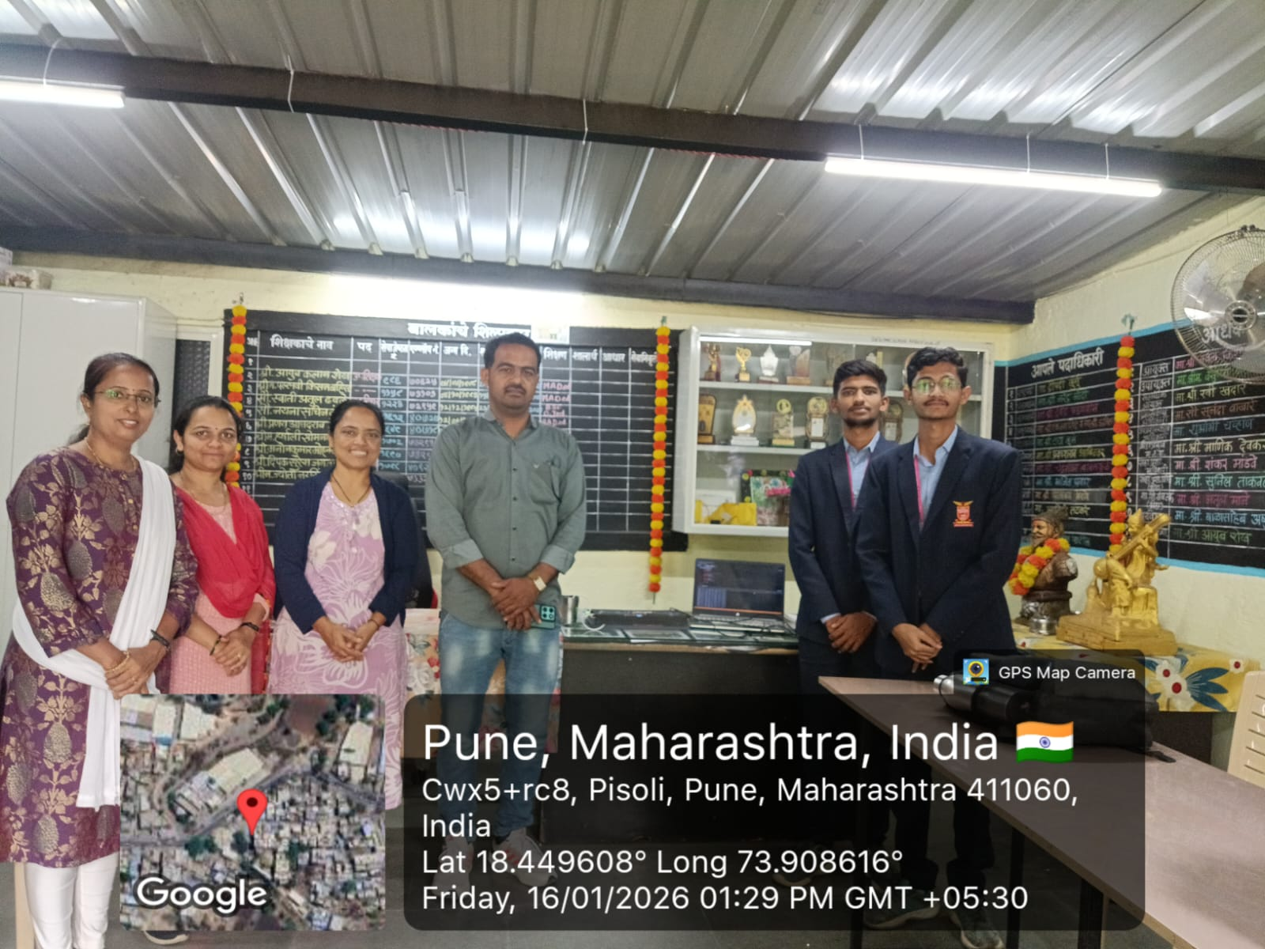
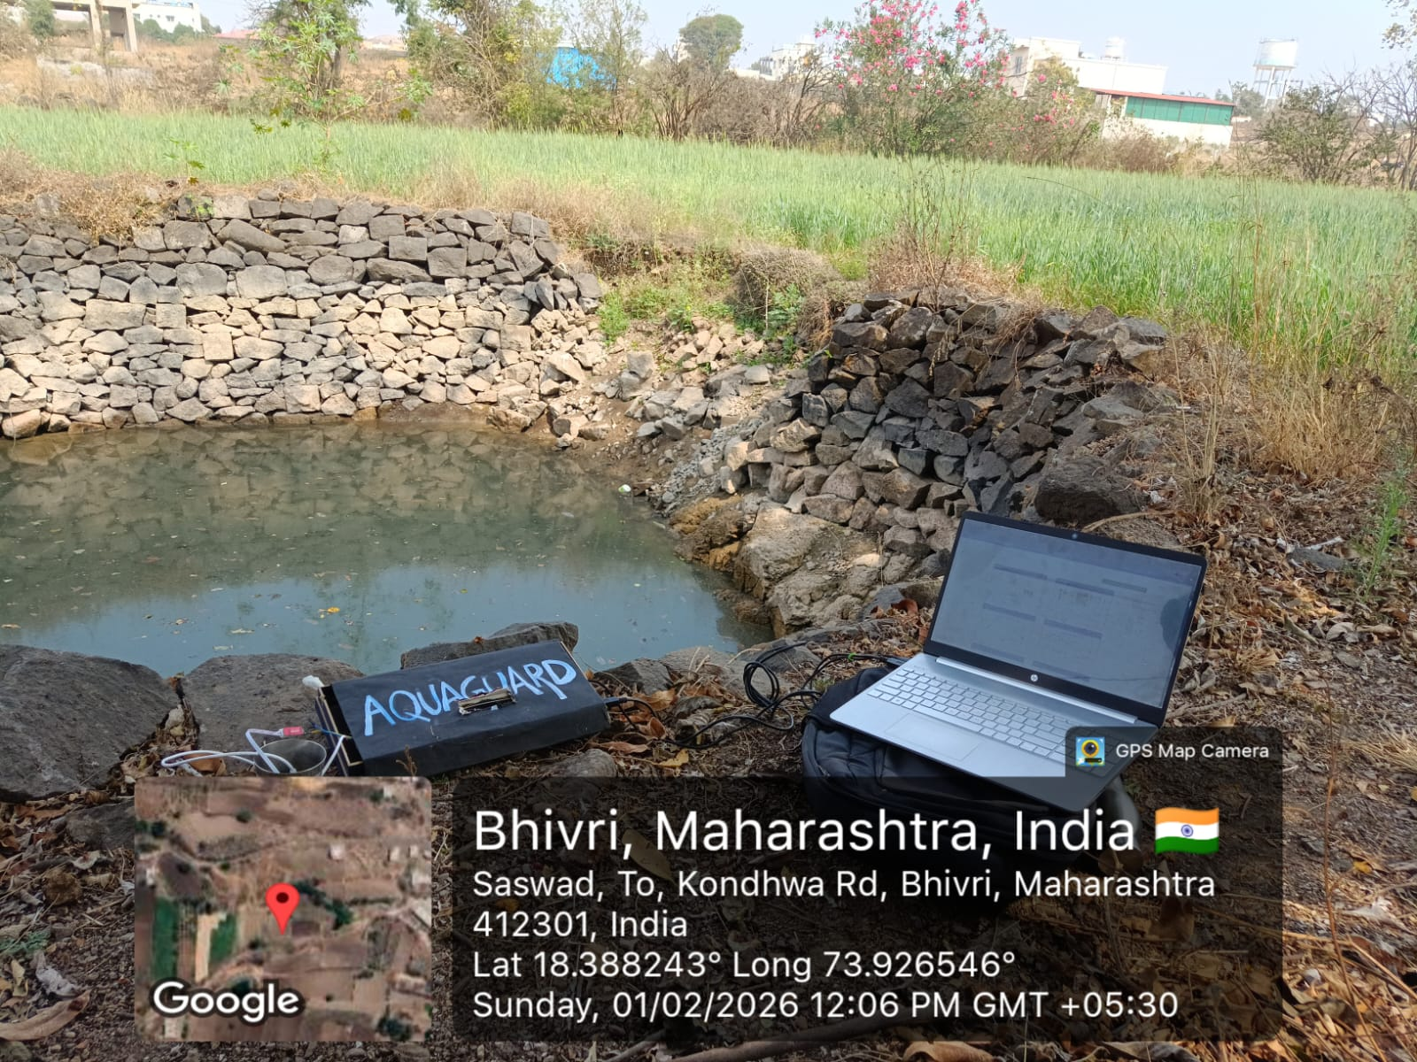
Snapshots of our project -

Slide 13
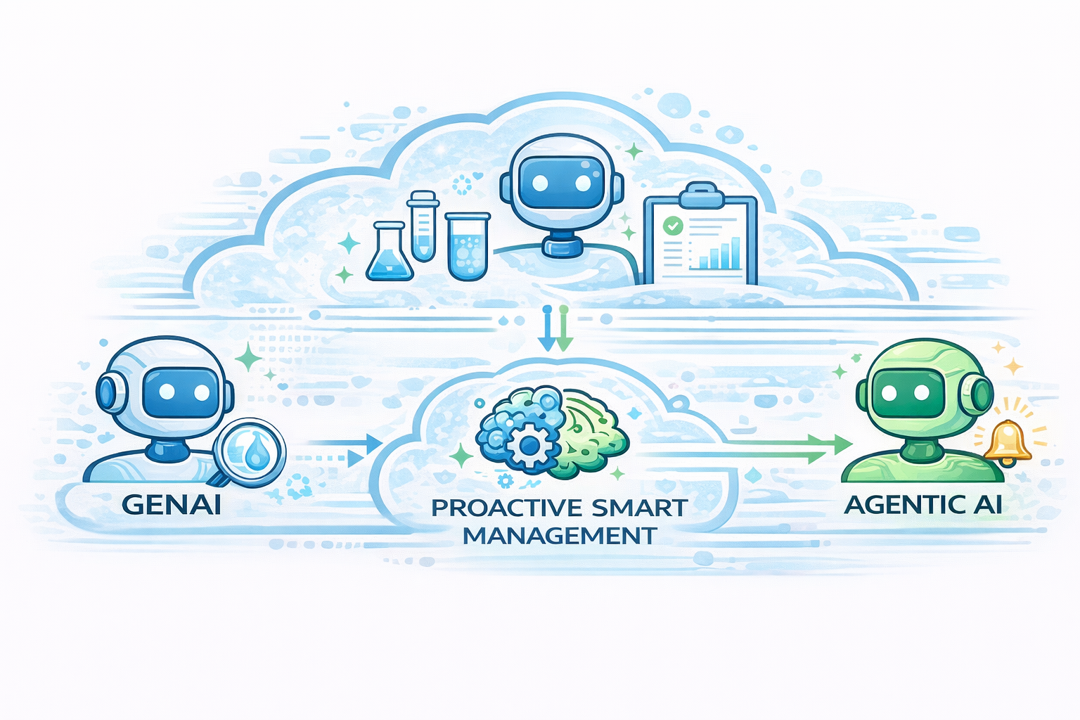
Role of Agentic AI and Gen AI in our solution
Interprets the severity of contamination and explains whether the issue is minor, moderate, or critical.
Generates practical and suitable suggestions to treat or purify the water based on the detected condition.
Recommends corrective steps such as filtration, RO treatment, boiling, or other purification methods depending on parameter levels.
Supports users by providing clear guidance, helping them take informed and timely action to make the water safe for use.

Slide 14
Novelty and Uniqueness
1
2
3
4
24×7 real-time integrated multi-parameter water quality monitoring platform
Smart threshold-based decision system enabling automatic water safety detection
Cloud-connected monitoring with instant email and SMS alerts for rapid response
calable, low-cost architecture designed for rural and smart-city water management

Slide 15
Git Hub Link
https://github.com/VidhiBawane15/VOIS_Team-41

Slide 16
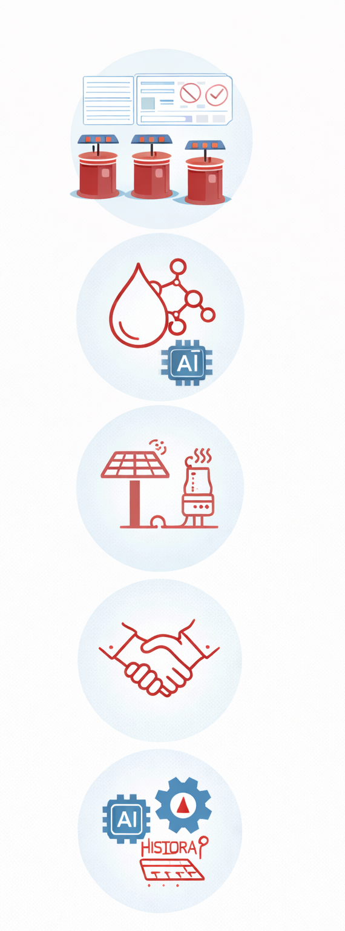
Future Scope
Deployment across multiple rural wells through centralized dashboards
Integration of AI-based contamination prediction for wells
Solar-powered standalone operation for remote rural areas
Collaboration with rural water supply authorities
AI-based contamination prediction using historical sensor data
Advanced threshold customization based on water usage patterns

Slide 17
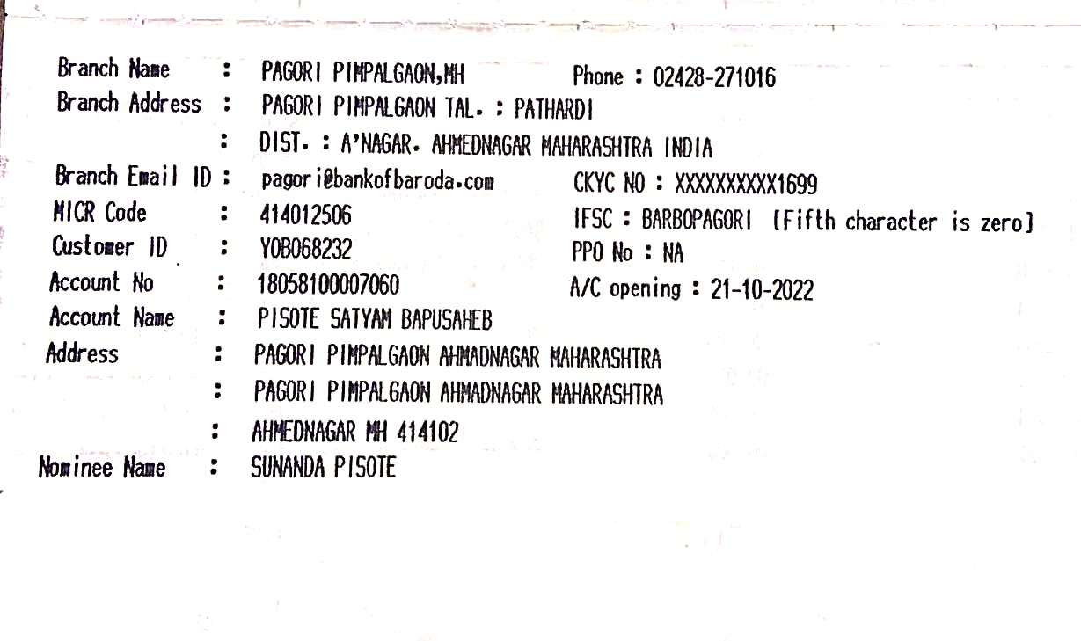
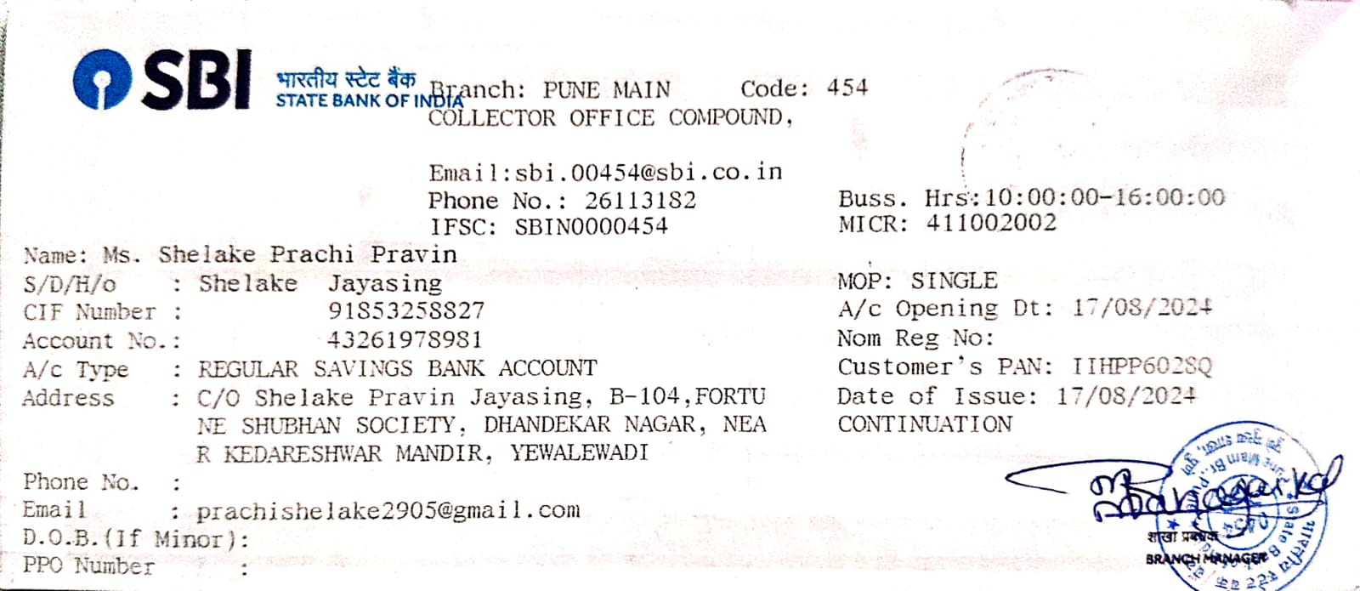
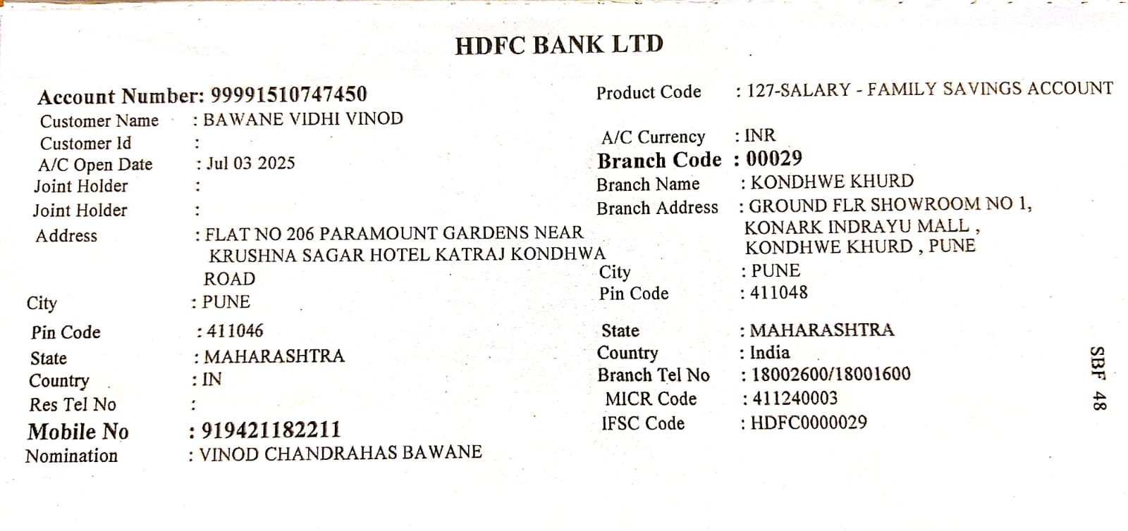
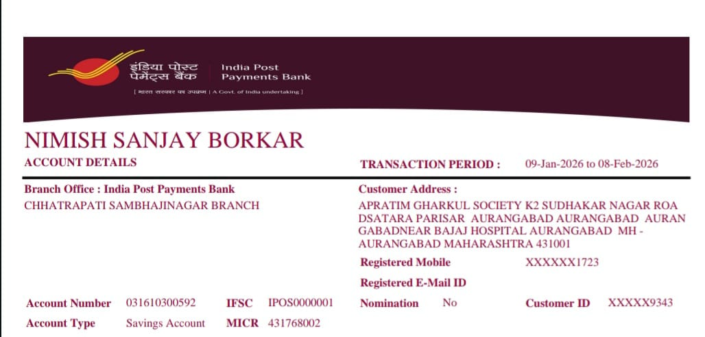
Bank Details
Full Name (as per bank records): | Bank Name | Branch Name | Account Number | Account Type (Savings / Current) | IFSC Code
Satyam Pisote | Bank of Baroda | Pagori Pimpalgaon | 18058100007060 | Saving | BARB0PAGORI
Prachi Shelake | State Bank of India | PUNE Main | 43261978981 | Saving | SBIN0000454
Vidhi Bawane | HDFC Bank | Kondhwe khurd | 99991510747450 | Saving | HDFC0000029
Nimish Borkar | India post payments Bank | Chhatrapatisambhajinagar | 031610300592 | Saving | IPOS0000001
Team Member 1
Pisote Satyam Bapusaheb)
Team Member 2
(Shelake Prachi Pravin)
Team Member 3
(Vidhi Vinod Bawane)
Team Member 4
(Nimish Sanjay Borkar)

Slide 18
Thank You

